Slide 1



PRESENTED BY: Akshaya & Mukesh
DATABASE
TRAINING
Notes:
Type your notes

Slide 2










Database Training
AGENDA
MINUTES of MEEting
History Of DBMS and RDBMS
DB Components, Datatypes
Database Designing and Modelling
SQL Commands and Clauses
Intro On SQL and MYSQL
Joins, SubQueries, Views and Stored Procedure
Notes:
Type your notes

Slide 3
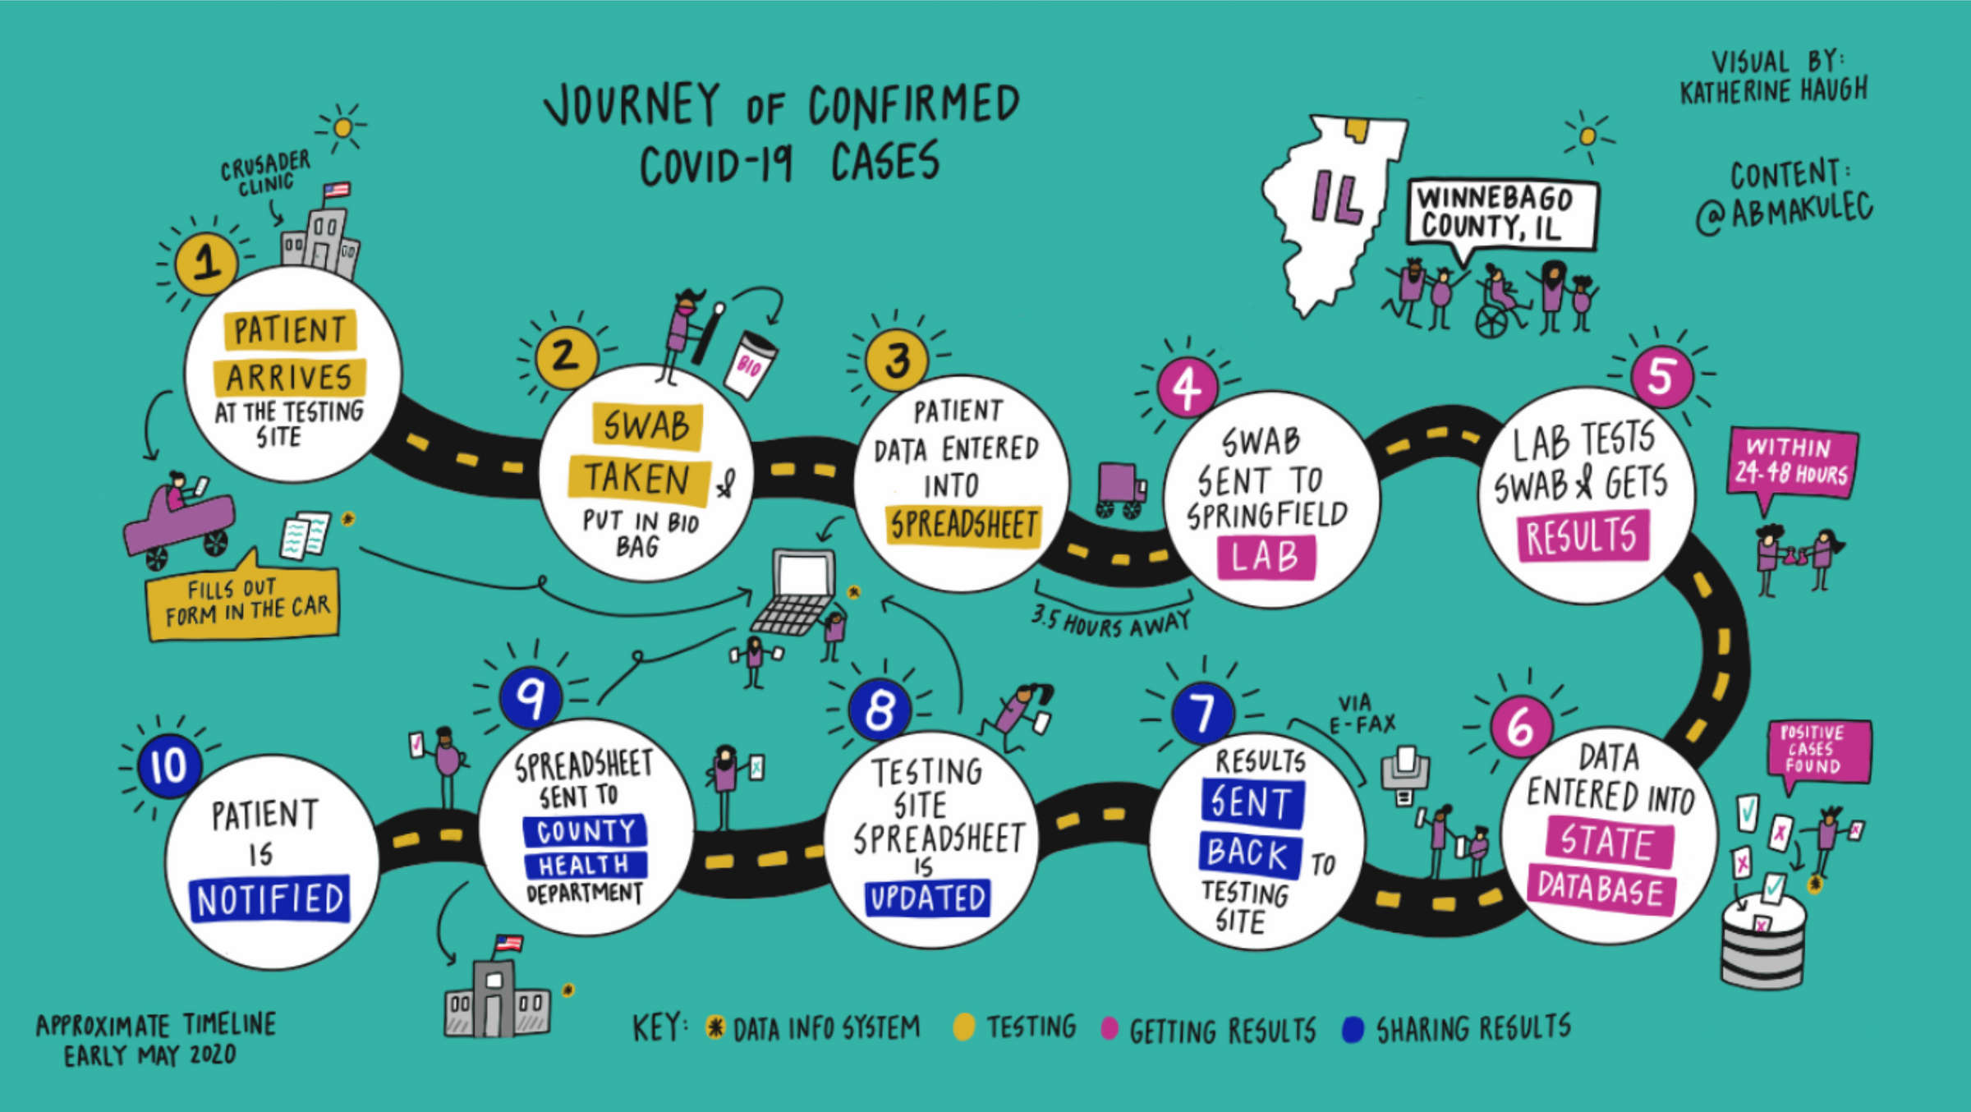
HOW IS DATA COLLECTED ?
SLIDE
Notes:
Type your notes

Slide 4








Quick Comparison
Terms listed below and their definition :
vs
vs
DATA
DATABASE
DBMS
IT IS A COLLECTION OF FACTS AND FIGURES THAT CAN BE RECORDED
IT IS A COLLECTION OF DATA. A PLACE WHERE RELATED DATA IS STORED
A COLLECTION OF PROGRAM THAT ENABLES USERS TO MAINTAIN THE DATABASE
Notes:
Type your notes

Slide 5


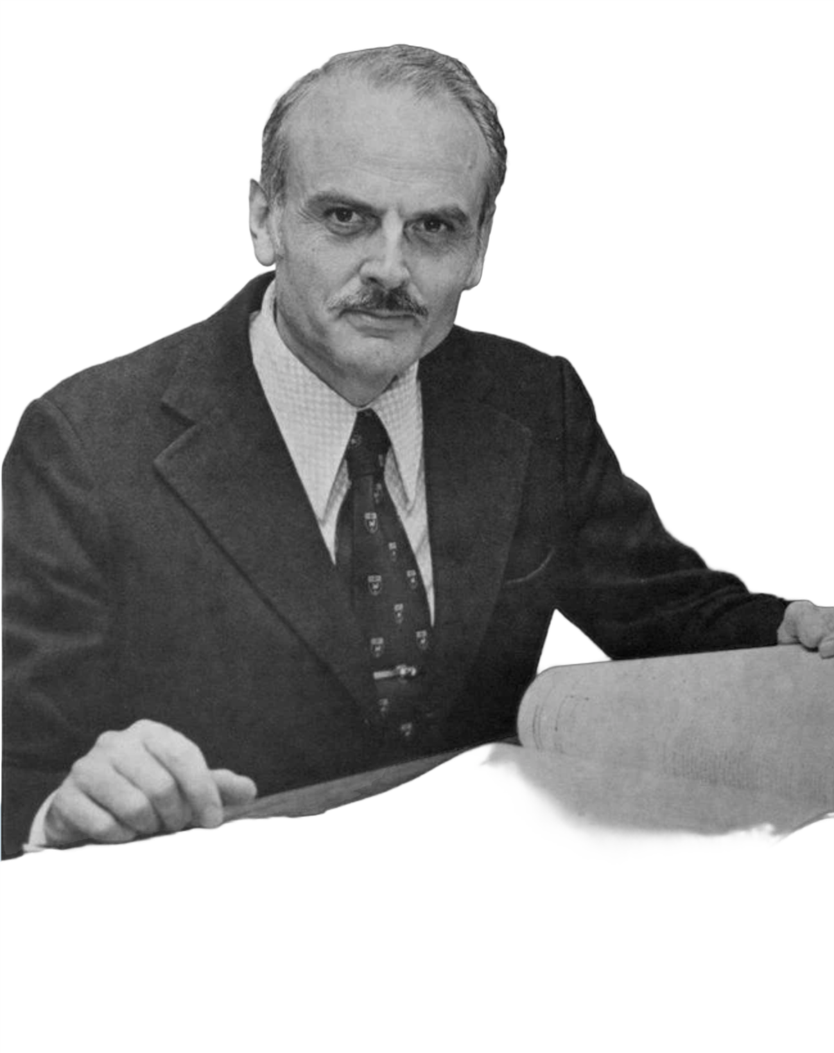
What is RDBMS ?
Relation Database Management System is a DBMS that is the basis for SQL, and for all modern database systems like MS SQL Server, IBM DB2, Oracle, MySQL, and Microsoft Access
RDBMS is based on the relational model as introduced by E. F. Codd.
The data in an RDBMS is stored in database objects which are called as tables.
Notes:
Type your notes

Slide 6

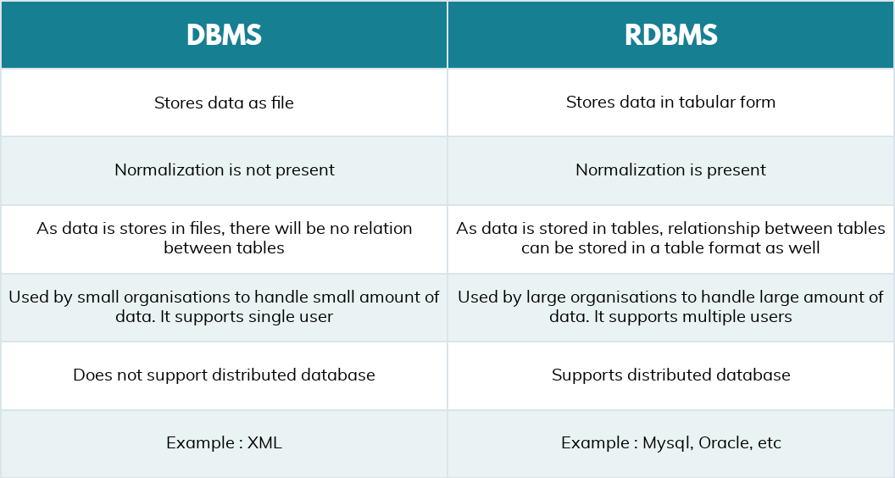
Quick Comparison
Notes:
Type your notes

Slide 7

What is data MODELLING ?
It is a process of defining and designing a database so that it can efficiently store, manage, and retrieve data
Notes:
Type your notes

Slide 8

Why do we do
data MODELLING ?
Structured Data
No Data Redundancy
Faster Query Processing
Notes:
Type your notes

Slide 9






STEPS TO BUILD A DATA MODEL
Let’s consider sales as our use case.
BUSINESS
GRAIN
DIMENSIONS
FACTS
Sales Processing
Level of detail at which we want to capture data
Categories or characteristics that we use to describe the data
Measurable data points that we want to capture within each combination of dimensions
Notes:
Type your notes

Slide 10
Let’s Build a Data MODEL for cake sales
Business : Cake Sales
Grain : Cake sales per day
Dimensions :
Date: The date on which the cake was sold.
Product: The type of cake sold (e.g., chocolate, vanilla, strawberry, etc.).
Location: The location where the cake was sold (e.g., in-store, online, etc.).
Customer: The customer who purchased the cake.
Facts :
Quantity: The number of cakes sold per day.
Revenue: The amount of money earned from cake sales per day.
Cost: The cost of producing the cakes sold per day.
Profit: The revenue minus the cost of producing the cakes sold per day.
Notes:
Type your notes

Slide 11







TYPES OF DATA MODELLING
Data models provide a blueprint for designing a new database
CONCEPTUAL
They provide a big-picture view of what the system will contain
They provide detail information about the data elements and relationships
LOGICAL
They provide a schema for how the data will be physically stored within a database
PHYSICAL
Notes:
Type your notes

Slide 12
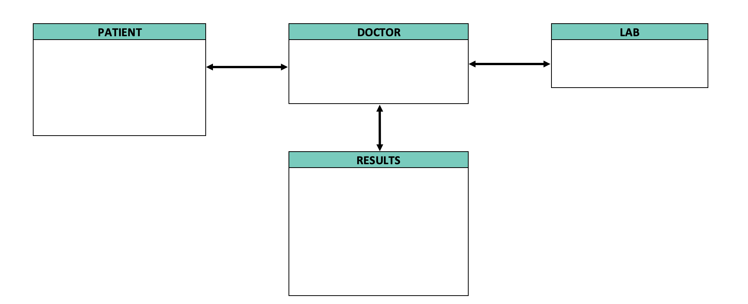
CONCEPTUAL MODELLING
Notes:
Add note to this slide

Slide 13
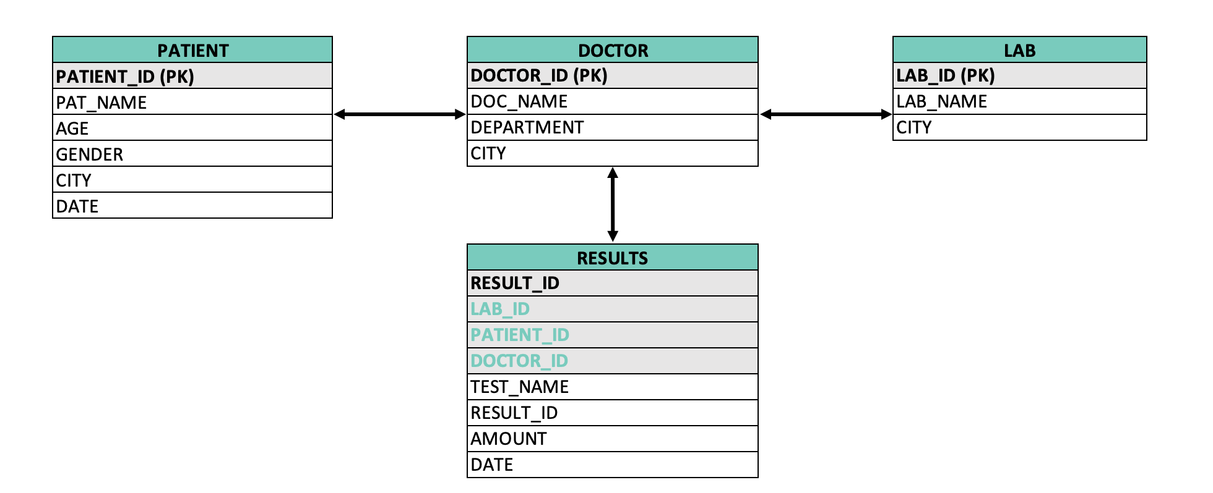
LOGICAL MODELLING
Notes:
Add note to this slide

Slide 14
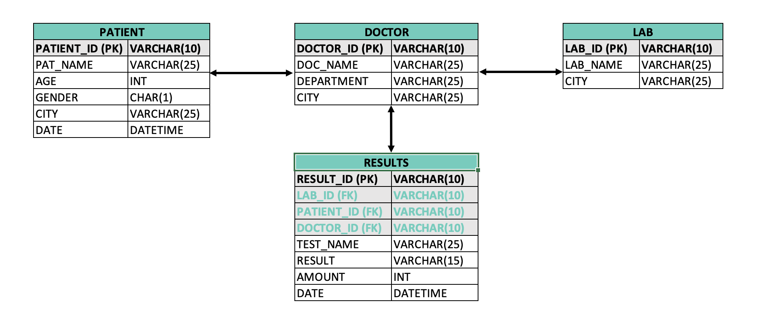
PHYSICAL MODELLING
Notes:
Add note to this slide

Slide 15
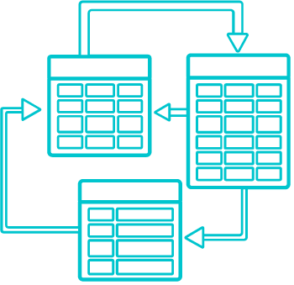
What is ER Modelling ?
ER model stands for an Entity-Relationship model. It defines the data elements and relationship for a specified system.
It develops a very simple and an easy conceptual design for the database
Entity-Relationship Diagram (ERD) is a modelling and a database documentation tool.
Notes:
Type your notes

Slide 16
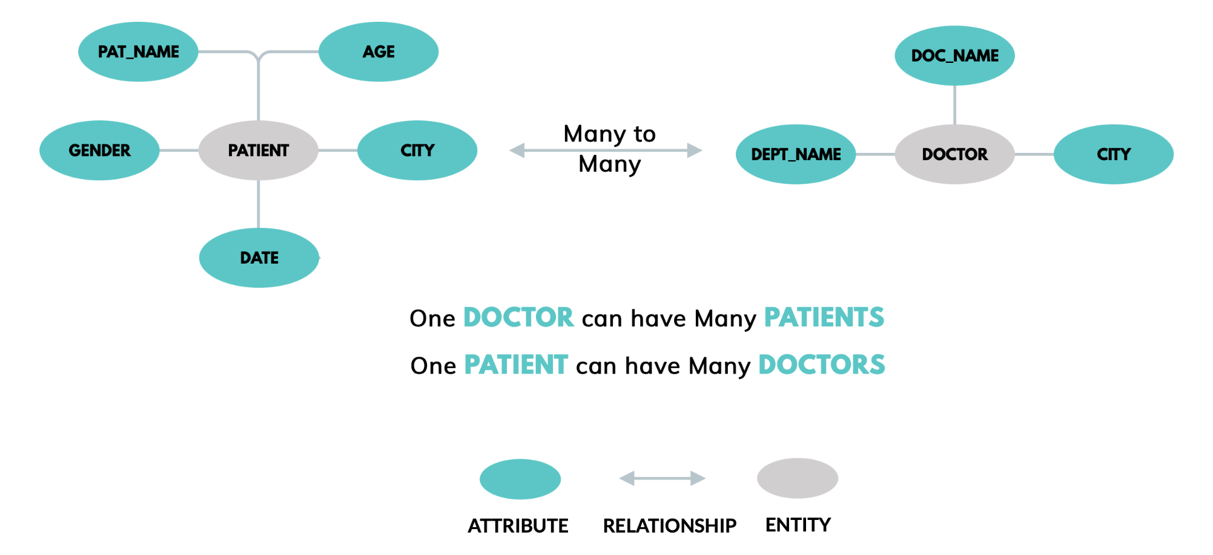
ENTITY-RELATIONSHIP MODELLING
Notes:
Add note to this slide

Slide 17
QUICK COMPARISON
DIMENSIONS
FACTS
Descriptive attributes that provide context and help in analysing facts
Categorical or qualitative data
Important for providing context and insights into data
Dimensions cannot be aggregated as they provide context to the facts
Dimensions can be at any level of granularity, from high-level categories to more specific attributes
Specific data points that can be measured or counted
Numeric or measurable data
Essential for making informed decisions
Facts can be aggregated or summarized to provide higher-level insights
Facts are at the lowest level of granularity
VS
Essential for making informed decisions

Slide 18

TYPE OF SCHEMAS
STAR SCHEMA
SNOWFLAKE SCHEMA
Notes:
Add note to this slide

Slide 19
QUICK COMPARISON
STAR SCHEMA
SNOWFLAKE SCHEMA
High Data Redundancy
Denormalized data stored in a single table
Query performance is faster with fewer joins
Uses more space
Used for less complex data warehouses
Low Data Redundancy
Normalized data stored in multiple tables
Query performance is slower due to more joins
Uses less space
Used for more complex data warehouses
VS
Essential for making informed decisions

Slide 20
SLOWLY CHANGING DIMENSIONS
A CONCEPT IN DATA WAREHOUSING THAT DESCRIBES HOW THE DIMENSIONS IN A DATA WAREHOUSE CHANGE OVER TIME
TYPE 0
The dimension data remains constant over time and no history data
INSERT
TYPE 1
The old data is overwritten with new data when a change occurs. No history
UPDATE
TYPE 2
New rows are added to the dimension table to track the historical changes in the data
UPSERT
Notes:
Type your notes

Slide 21
SCD – TYPE 0
Product ID | Product Name | Product Category
123 | iPhone | Electronics
456 | Samsung TV | Electronics
In this example, the product data remains constant over time and is never changed, hence no new records are added to the dimension table.
Notes:
Add note to this slide

Slide 22
SCD – TYPE 1
Employee ID | Employee Name | Job Title
101 | John Doe | Analyst
102 | Jane Smith | Director
In this example, if Jane Smith is promoted to a higher job title such as Director, the data in the dimension table would be updated as follows:
Employee ID | Employee Name | Job Title
101 | John Doe | Analyst
102 | Jane Smith | Manager
The old job title is overwritten with the new job title, and there is no historical tracking of the change.
Notes:
Add note to this slide

Slide 23
SCD – TYPE 2
Customer ID | Customer Name | Address | Start Date | End Date | Active Flag
1001 | John Smith | 123 Main Street | 2021-01-01 | 2022-05-30 | No
1001 | John Smith | 456 Elm Street | 2022-06-01 | NULL | Yes
In this example, the flag column indicates whether a record is currently active or not. The first record for John Smith's old address has an end date of 2022-05-30, indicating that it is no longer valid. The second record for John Smith's new address has a NULL end date, indicating that it is the current active record. History is maintained.
Notes:
Add note to this slide

Slide 24
TYPES OF KEYS
Following are some of the most used Keys in SQL
FORIEGN KEY
COMPOSITE KEY
Refers primary key of another table
Combination of two or more fields that together serve as the primary key
PRIMARY KEY
UNIQUE KEY
SURROGATE KEY
Uniquely identifies each row in a table
A field or combo of fields that must be unique
It is generated by the database system to serve as the primary key
Notes:
Type your notes

Slide 25
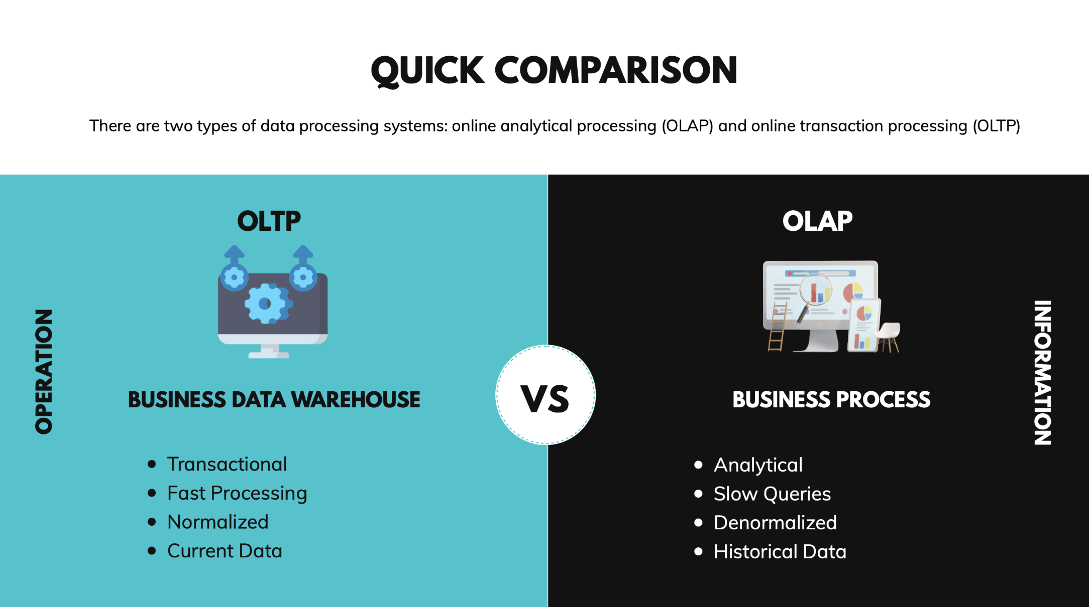

Slide 26
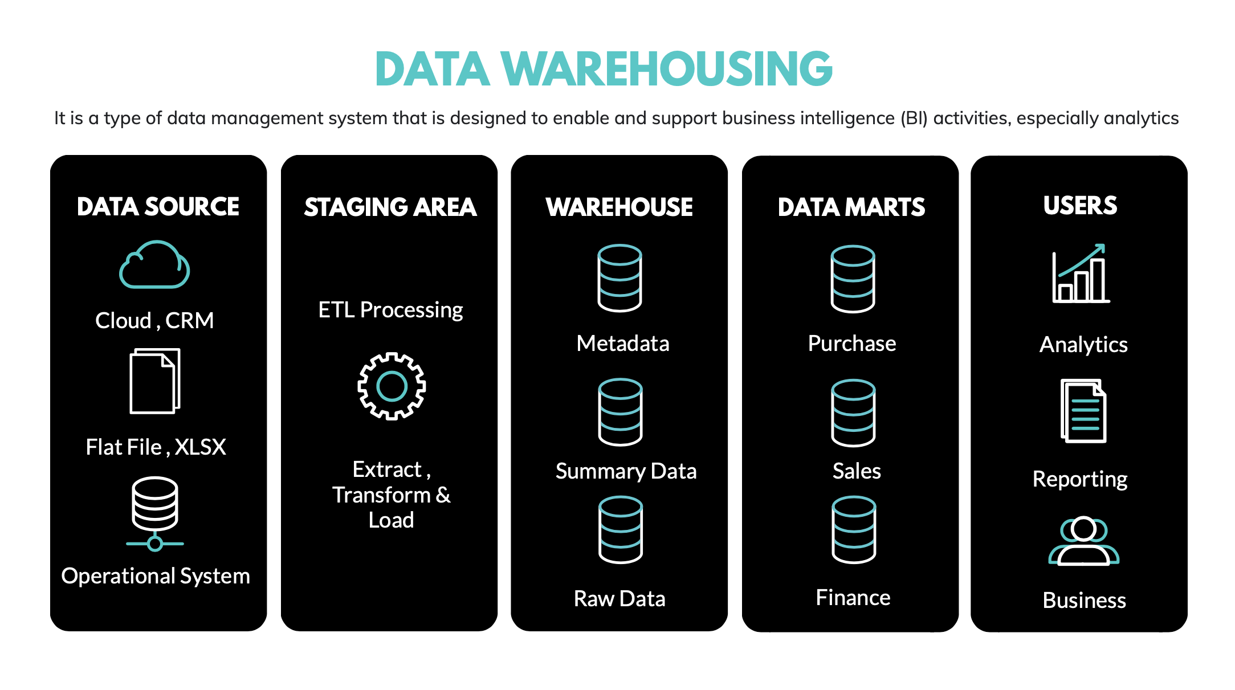

Slide 27

What is data redundancy ?
Repetition of data in table causing Insertion, Deletion and Updating issues
Notes:
Type your notes

Slide 28

What is normalization ?
A technique of organizing data into multiple related tables, to minimize Data Redundancy
Notes:
Type your notes

Slide 29








TYPES OF NORMALIZATION
1 NF
3 NF
4 NF
FIRST NORMAL FORM
THIRD NORMAL FORM
FOURTH NORMAL FORM
2 NF
BCNF
5 NF
SECOND NORMAL FORM
BOYCE-CODD NORMAL FORM
FIFTH NORMAL FORM
Notes:
Type your notes

Slide 30
FIRST NORMAL FORM - 1 NF
Each column should contain atomic values
Each column name should be unique
Columns should contain values that are of same type
Table must have primary key
A
B
Prime Attribute
Non-Prime Attribute
Full Dependency
Notes:
Add note to this slide

Slide 31
RULE 1
COL 1 | COL 2 | COL 3
A | X,Y
B | W,X
C | Y
D | Z
Must contain only ATOMIC values

Slide 32


RULE 1
COL 1 | COL 2 | COL 3
A | X,Y
B | W,X
C | Y
D | Z
Must contain only ATOMIC values

Slide 33
RULE 1
RULE 2
COL 1 | COL 2 | COL 3
A | X,Y
B | W,X
C | Y
D | Z
DOB | NAME
21-10-13 | Z
01-05-22 | X
06-09-20 | Y
C | 01-06-09
Columns should contain VALUES that are of SAME TYPE

Slide 34
RULE 1
RULE 2
COL 1 | COL 2 | COL 3
A | X,Y
B | W,X
C | Y
D | Z
DOB | NAME
21-10-13 | Z
01-05-22 | X
06-09-20 | Y
C | 01-06-09
Columns should contain VALUES that are of SAME TYPE

Slide 35
RULE 1
RULE 2
COL 1 | COL 2 | COL 3
A | X,Y
B | W,X
C | Y
D | Z
DOB | NAME
21-10-13 | Z
01-05-22 | X
06-09-20 | Y
C | 01-06-09
RULE 3
DOB | NAME | NAME
21-10-13 | A | W
01-05-22 | B | X
06-09-20 | C | Y
01-06-09 | D | Z
Each column must have a UNIQUE NAME

Slide 36
RULE 1
RULE 2
COL 1 | COL 2 | COL 3
A | X,Y
B | W,X
C | Y
D | Z
DOB | NAME
21-10-13 | Z
01-05-22 | X
06-09-20 | Y
C | 01-06-09
RULE 3
DOB | F_NM | L_NM
21-10-13 | A | W
01-05-22 | B | X
06-09-20 | C | Y
01-06-09 | D | Z
Each column must have a UNIQUE NAME

Slide 37
RULE 1
RULE 2
COL 1 | COL 2 | COL 3
A | X,Y
B | W,X
C | Y
D | Z
DOB | NAME
21-10-13 | Z
01-05-22 | X
06-09-20 | Y
C | 01-06-09
RULE 3
RULE 4
DOB | F_NM | L_NM
21-10-13 | A | W
01-05-22 | B | X
06-09-20 | C | Y
01-06-09 | D | Z
ID | DOB | NAME
1 | 21-10-13 | A
4 | 01-05-22 | B
3 | 06-09-20 | C
2 | 01-06-09 | D
PRIMARY KEY must be present. ORDER in which data is saved does NOT MATTER

Slide 38
SECOND NORMAL FORM - 2 NF
Should be in First Normal Form - 1NF
Should not have Partial Dependency
A
B
Part of Primary Key
Non-Prime Attribute
Partial Dependency
Notes:
Add note to this slide

Slide 39
WHAT is DEPENDENCY ?
Notes:
Type your notes

Slide 40
PATIENT
PAT_ID | NAME | AGE
PRIMARY KEY

Slide 41
PATIENT
PAT_ID | NAME | AGE
PRIMARY KEY is a key or group of keys that can fetch any row in a table UNIQUELY
PRIMARY KEY

Slide 42
PATIENT
PAT_ID | NAME | AGE
1 | RACHEL | 26
NAME of Patient with ID = 1

Slide 43
PATIENT
PAT_ID | NAME | AGE
1 | RACHEL | 26
AGE of Patient with ID = 1

Slide 44
PATIENT
PAT_ID | NAME | AGE
1 | RACHEL | 26
This is called Dependency or Functional Dependency

Slide 45
It’s time for PARTIAL
DEPENDENCY
Notes:
Type your notes

Slide 46
PATIENT
DOCTOR
PAT_ID | NAME | AGE
1 | MAY | 25
2 | JOHN | 31
3 | DANIEL | 46
4 | KATE | 29
DOC_ID | NAME
5 | MURIEL
6 | SUSAN
7 | LILA
8 | COOPER
Many to
Many
APPOINMENT
APP_ID | PAT_ID | DOC_ID | DEPT | DATE
A1 | 1 | 7 | ENT | 21-01-22
A2 | 2 | 6 | EMG | 01-03-22
A3 | 4 | 8 | PID | 06-02-22
A4 | 1 | 8 | PID | 23-01-22
APP_ID is the PRIMARY key
But PAT_ID + DOC_ID makes a meaning full
PRIMARY KEY

Slide 47
APPOINMENT
APP_ID | PAT_ID | DOC_ID | DEPT | DATE
A1 | 1 | 7 | ENT | 21-01-22
A2 | 2 | 6 | EMG | 01-03-22
A3 | 4 | 8 | PID | 06-02-22
A4 | 1 | 8 | PID | 23-01-22
?
?

Slide 48
APPOINMENT
APP_ID | PAT_ID | DOC_ID | DEPT | DATE
A1 | 1 | 7 | ENT | 21-01-22
A2 | 2 | 6 | EMG | 01-03-22
A3 | 4 | 8 | PID | 06-02-22
A4 | 1 | 8 | PID | 23-01-22
?
?

Slide 49
PAT_ID + DOC_ID
Can uniquely identify any row from the APPOINTMENT table
Notes:
Type your notes

Slide 50
APPOINMENT
DEPT column is only dependent on DOC_ID and not PAT_ID
APP_ID | PAT_ID | DOC_ID | DEPT | DATE
A1 | 1 | 7 | ENT | 21-01-22
A2 | 2 | 6 | EMG | 01-03-22
A3 | 4 | 8 | PID | 06-02-22
A4 | 1 | 8 | PID | 23-01-22
This is PARTIAL DEPENDENCY

Slide 51
APPOINMENT
APP_ID | PAT_ID | DOC_ID | DEPT | DATE
A1 | 1 | 7 | ENT | 21-01-22
A2 | 2 | 6 | EMG | 01-03-22
A3 | 4 | 8 | PID | 06-02-22
A4 | 1 | 8 | PID | 23-01-22
DOCTOR
PAT_ID | NAME
5 | MURIEL
6 | SUSAN
7 | LILA
8 | COOPER

Slide 52
DOCTOR
DEPARMENT
PAT_ID | NAME | DEPT
5 | MURIEL | ENT
6 | SUSAN | EMG
7 | LILA | PID
8 | COOPER | PID
DPT_ID | NAME
1 | ENT
2 | EMG
3 | PID
4 | ORT
(OR)

Slide 53
THIRD NORMAL FORM - 3 NF
Should be in Second Normal Form - 2NF
Should not have Transitive Dependency
A
B
Non-Prime Attribute
Non-Prime Attribute
Transitive Dependency
Notes:
Add note to this slide

Slide 54
We want to save more information in the APPOINTMENT table
TEST_NAME & AMOUNT
Notes:
Type your notes

Slide 55
APPOINMENT
ID | PAT_ID | DOC_ID | TEST_NAME | AMOUNT | DATE
A1 | 1 | 7 | RT_PCR | 800 | 21-01-22
A2 | 2 | 6 | MALARIA | 500 | 01-03-22
A3 | 4 | 8 | BP | 600 | 06-02-22
A4 | 1 | 8 | COLD | 300 | 23-01-22

Slide 56
APPOINMENT
ID | PAT_ID | DOC_ID | TEST_NAME | AMOUNT | DATE
{
PRIMARY KEY

Slide 57

APPOINMENT
ID | PAT_ID | DOC_ID | TEST_NAME | AMOUNT | DATE
{
PRIMARY KEY
Depends on

Slide 58
APPOINMENT
ID | PAT_ID | DOC_ID | TEST_NAME | AMOUNT | DATE
{
PRIMARY KEY
Depends on
Not a PRIMARY
KEY
This is TRANSITIVE DEPENDENCY

Slide 59
APPOINMENT
ID | PAT_ID | DOC_ID | TEST_NAME | AMOUNT | DATE

Slide 60
APPOINMENT
ID | PAT_ID | DOC_ID | TEST_NAME | DATE
A1 | 1 | 7 | RT_PCR | 21-01-22
A2 | 2 | 6 | MALARIA | 01-03-22
A3 | 4 | 8 | BP | 06-02-22
A4 | 1 | 8 | COLD | 23-01-22
TEST
TEST_NAME | AMOUNT
RT_PCR | 800
MALARIA | 500
BP | 400
COLD | 300

Slide 61

BOYCE CODD NORMAL FORM - BCNF
Should be in Third Normal Form - 3NF
For any dependency A B, A should be a Super Key
A
B
Non-Prime Attribute
Prime Attribute
BOYCE CODD Dependency
Notes:
Add note to this slide

Slide 62
FOURTH NORMAL FORM - 4 NF
Should be in BCNF Normal Form
It should not have Multi-Valued Dependency
FOURTH NORMAL FORM - 5 NF
Should be in Fourth Normal Form - 4 NF
It should not have Join Dependency
Notes:
Add note to this slide

Slide 63





WHAT IS SQL ?
SQL stands for Structured Query Language
Its main aim is to store, access and manipulate data in Relational DB
All RDBMS use SQL as standard database language
SQL was developed at IBM by Donald D.Chamberlin (L) and Raymond F. Boyce (R)
SELECT
INSERT
UPDATE
DELETE
DML
CREATE
ALTER
DROP
TRUCATE
DDL
TYPES OF SQL
COMMANDS
GRANT
REVOKE
DCL
TCL
COMMIT
ROLLBACK
Notes:
Type your notes

Slide 64

WHAT IS MYSQL ?
MySQL, now owned and managed by oracle corporation, is a type of Relational Database Management System
It is an open-source platform that allows one to store, retrieve and manage relational databases
MySQL uses SQL queries to perform actions on the database
Google, Facebook, and many other companies have MySQL as their preferred choice of database system for managing large volume of data
Notes:
Type your notes

Slide 65
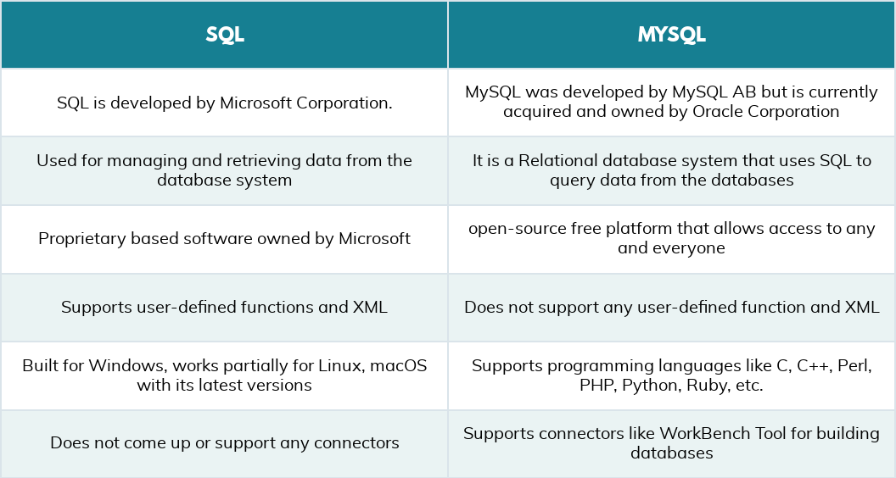
Quick Comparison
Notes:
Type your notes

Slide 66





DB COMPONENTS
relational model can be represented as a table of rows and columns
TABLE
RECORD
Components OF RDBMS
COLUMN
DOMAINS
SCHEMA
CONSTRAINTS
Notes:
Type your notes

Slide 67
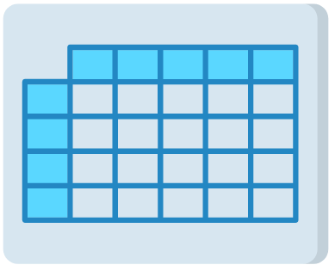
WHAT IS A TABLE ?
A table is a collection of data represented in rows and columns
Multiple tables might comprise a database
{
ROW
COLUMN
Notes:
Add note to this slide

Slide 68
WHAT IS A COLUMN ?
A column or field, is a specific category of information that exists in a table
A column is to a table what an attribute is to an entity
Each column in a table is assigned a data type
Notes:
Add note to this slide

Slide 69
WHAT IS A ROW ?
A row of data is the collection of all the columns in a table associated with a single occurrence
A row of data is a single record in a table
Notes:
Add note to this slide

Slide 70



WHAT IS A SCHEMA ?
A schema is a group of related objects in a database
It describes both the organization of data and the relationships between tables in a given database
Client
server
database
External / View Level
Conceptual/Logical Level
Internal Level
3 TIRE ARCHITECTURE
Notes:
Add note to this slide

Slide 71
WHAT IS A DOMAIN ?
Domain is the data type used by a column in a database
It is a set of acceptable values that a column is allowed to contain
Notes:
Add note to this slide

Slide 72
WHAT IS A CONSTRAINT ?
Constraints are the rules enforced on the data columns of a table
These are used to limit the type of data that can go into a table
Constraints could be either on a column level or a table level
Notes:
Add note to this slide

Slide 73


TYPES OF CONSTRAINTS
Following are some of the most commonly used constraints available in SQL
NOT NULL
PRIMARY KEY
FORIEGN KEY
INDEX
Prevent actions that would destroy links between tables
Used to create and retrieve data from the database very quickly
Column cannot have NULL value
Uniquely identifies each row in table
DEFAULT
UNIQUE
CHECK
Provides a default value for a column when none is specified
Ensures that all values in a column are different
Ensures that all the values in a column satisfies certain condition
Notes:
Type your notes

Slide 74
WHAT IS A DATATYPE ?
A data type determines the type of data that can be stored in a database column.
Three of the most commonly used data types are,
Alphanumeric
Numeric
Date and time
Notes:
Add note to this slide

Slide 75
ALPHANUMERIC DATATYPE
This data type is used to store characters, numbers, special characters, or nearly any combination.
If a numeric value is stored in an alphanumeric field, the value is treated as a character, not a number.
Notes:
Add note to this slide

Slide 76
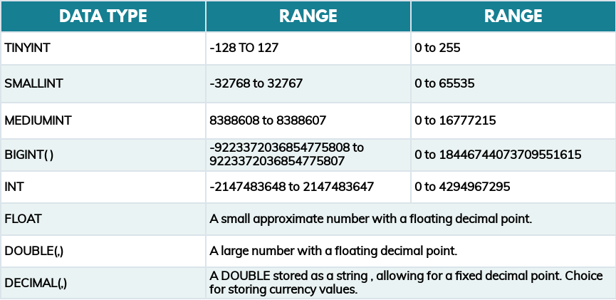
NUMERIC DATATYPE
Numeric data types are used to store only numeric values
Notes:
Add note to this slide

Slide 77
DATE AND TIME DATATYPE
Date and Time data types are used to store date and time values, which widely vary depending on the RDBMS used.
Some of the formats used,
Date : yyyy-mm-dd
Date Time : yyyy-mm-dd hh:mm:ss
Timestamp : yyyymmddhhmmss
Time : hh:mm:ss
Notes:
Add note to this slide

Slide 78
DML COMMANDS
SELECT : Selects data from the database ​
Syntax : ​ SELECT <column_names> FROM <table_name>;​
INSERT : Inserts data into the table ​
Syntax : ​INSERT INTO <Table_Name>(column_1,column_2,...) VALUES (value_1,value_2,...);​
UPDATE : Updates data in the table based on values ​
Syntax : ​UPDATE <tablename> SET <columnname> = <new value> [ WHERE condition] ​
DELETE : Deletes data from the table​
Syntax : ​DELETE FROM <tablename> [WHERE condition]​
Notes:
Type your notes

Slide 79
DDL COMMANDS
CREATE : Creates table or database ​
Syntax : ​ CREATE TABLE <table_name> (column1 datatype,column2 datatype, column3 datatype,....);
ALTER : To Add/ Delete/ Modify a column in a table ​ ​
Add/Modify Syntax : ​ALTER TABLE <table_name> ADD COLUMN / MODIFY column_name datatype;
Delete Syntax : ALTER TABLE <table_name> DROP COLUMN column_name; ​
DROP : Drops an existing table in a database ​
Syntax : ​DROP TABLE <table_name>;
TRUNCATE : Removes all the data from the table​
Syntax : ​TRUNCATE TABLE <table_name>;
Notes:
Type your notes

Slide 80


SQL CLAUSE
Below is the order in which a query will execute
FROM
WHERE
GROUP BY
HAVING
SELECT
ORDER BY
ORDER OF EXECUTION
Notes:
Type your notes

Slide 81
WHERE CLAUSE
WHERE clause is used to select a particular data based on the condition ​
Syntax : SELECT * FROM <table_name> WHERE condition;
Logical Operator : AND, OR, NOT​
Comparison Operation : >,< = <>​
Keywords : IN & NOT IN
Notes:
Add note to this slide

Slide 82
GROUP BY CLAUSE
Used to arrange identical data into groups with the help of some functions - sum(), avg(), max(), min()​
Syntax : SELECT col1, function_name(col2) FROM <table_name>WHERE condition GROUP BY col1, col2 ;
Notes:
Add note to this slide

Slide 83
HAVING CLAUSE
The HAVING clause was added to SQL because the WHERE keyword cannot be used with aggregate functions.
Syntax : SELECT column_name(s)FROM table_name
WHERE condition GROUP BY column_name(s) HAVING conditionORDER BY column_name(s);
Notes:
Add note to this slide

Slide 84
ORDER BY CLAUSE
Used to sort the query result sets in either ascending or descending order
Syntax : SELECT <columnnames> FROM <tablename> [WHERE condition]​ ORDER BY <column> [ASC|DESC]​;
ASC is default.
Notes:
Add note to this slide

Slide 85
LIKE & WILDCARD CHARACTER
Check whether a string has specific pattern or not. ​
Used in WHERE Clause. ​
Syntax : WHERE <column_name> LIKE <pattern>​
WILDCARD Character ​:
Percentage (%) : matches any string of zero or more character​
Underscore (_) : matches any single character​
Notes:
Add note to this slide

Slide 86
BETWEEN
Used to specify whether a value is in a range. ​
Syntax : WHERE <column_name> BETWEEN <start_value> AND <end_value>​
Notes:
Add note to this slide

Slide 87
DISTINCT & LIMIT
Distinct : Returns only the unique values (i.e., removes the duplicate) . Works with SELECT ​clause
Syntax : SELECT DISTINCT <column_name> FROM <tablename>​
Limit : Restrict the number of row in the result ​
Syntax : SELECT <column_names> FROM <tablename> [ WHERE condition] LIMIT <number>;​
Notes:
Add note to this slide

Slide 88
UNION
The UNION operator is used to combine the result-set of two or more SELECT statements. It selects only distinct values by default
Must have same number of columns
Must have similar data types
Must have columns in same order
​
Syntax : SELECT column_name(s) FROM table1 UNION SELECT column_name(s) FROM table2;
Notes:
Add note to this slide

Slide 89
UNION ALL
The UNION ALL operator is also used to combine the result-set of two or more SELECT statements. It selects duplicate values also. The rules are same as union command
​
Syntax : SELECT column_name(s) FROM table1 UNION ALL SELECT column_name(s) FROM table2;
Notes:
Add note to this slide

Slide 90
UNION ALL
The UNION ALL operator is also used to combine the result-set of two or more SELECT statements. It selects duplicate values also. The rules are same as union command
​
Syntax : SELECT column_name(s) FROM table1 UNION ALL SELECT column_name(s) FROM table2;
Notes:
Add note to this slide

Slide 91






TYPES OF JOIN
Linking data between one (self-join) or more tables based on values of the common column between the tables
INNER JOIN
LEFT JOIN
All records that match between
table A and table B
All records of table A and common records between table A and table B
OUTER JOIN
RIGHT JOIN
All records of table A and table B even the records that don't match.
All records of table B and common records between table A and table B
Notes:
Type your notes

Slide 92
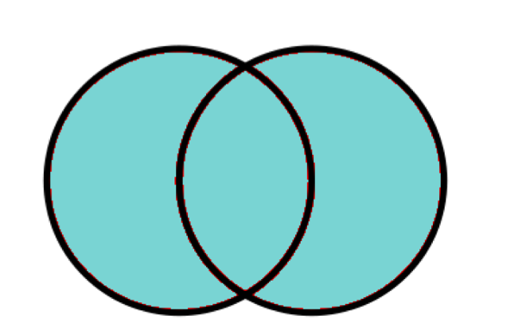
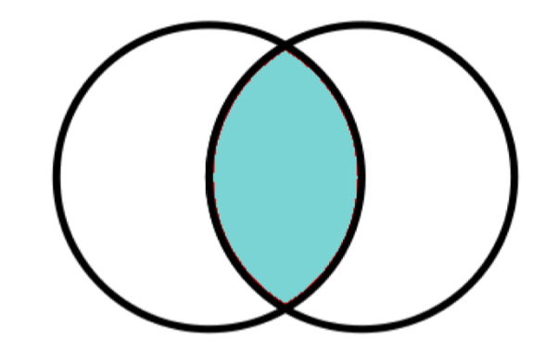
INNER & OUTER JOIN
Comparison OF JOINS
Table A
Table B
Table A
Table B
Syntax : SELECT <column_names> FROM <table1_name> INNER JOIN <table2_name> ON <condition> ​
Syntax : SELECT <column_names> FROM <table1_name> OUTER JOIN <table2_name> ON <condition>
Notes:
Type your notes

Slide 93
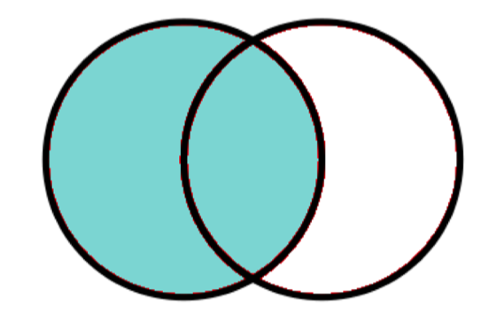
RIGHT & LEFT JOIN
Comparison OF JOINS
Table A
Table B
Table A
Table B
Syntax : SELECT <column_names> FROM <table1_name> RIGHT JOIN <table2_name> ON <condition> ​
Syntax : SELECT <column_names> FROM <table1_name> LEFT JOIN <table2_name> ON <condition>
Notes:
Type your notes

Slide 94
SUB QUERY
A sub query is a select query that is contained inside another query
The inner select query is usually used to determine the results of the outer select query
Can be use in SELECT, FROM, WHERE, HAVING and ORDER BY
Syntax : SELECT * FROM <table_name1> WHERE column1 IN (SELECT column1 from <table_name2>)
Notes:
Type your notes

Slide 95
VIEW
View is a virtual table, created using Create View command
Views contains the data retrieved from a query expression
View can be created from one or more tables ​
Syntax : CREATE VIEW <view_name> AS SELECT statement;​
Notes:
Type your notes

Slide 96
WHAT IS STORED PROCEDURE ?
A stored procedure is a prepared SQL code that you can save, so the code can be reused over and over again
Syntax :
Change the delimiter​
Define the procedure with its name and arguments​
After BEGIN, write the SQL commands​
Terminate the procedure with END followed by custom delimiter
Change the delimiter back to ;​
Notes:
Add note to this slide

Slide 97
STORED PROCEDURE SYNTAX
Syntax to create SP :
​
DELIMITER &&​
​
CREATE PROCEDURE <Procedure_Name> (param_spec1, param_spec2, …, param_specn )​
BEGIN​
<sql_statement>​
END &&
​
DELIMITER ;
Syntax to call the SP :
CALL <Procedure_Name>();​
Notes:
Add note to this slide

Slide 98




THANK
YOU
TIME TO GET YOUR QUESTIONS
ANSWERED...
Notes:
Type your notes

